Slide 1


Slide 2


Slide 3
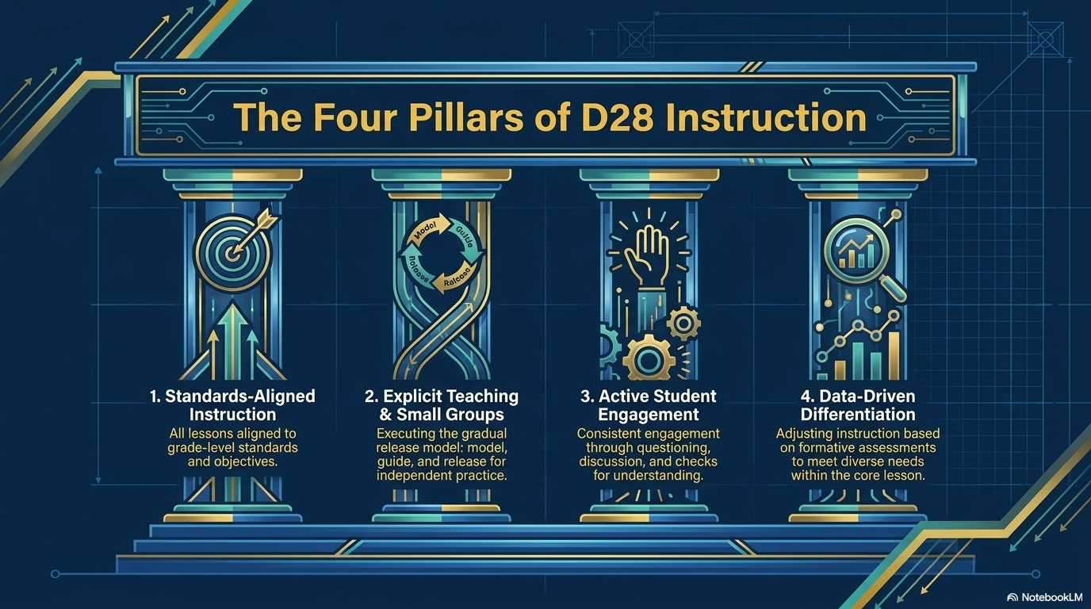

Slide 4
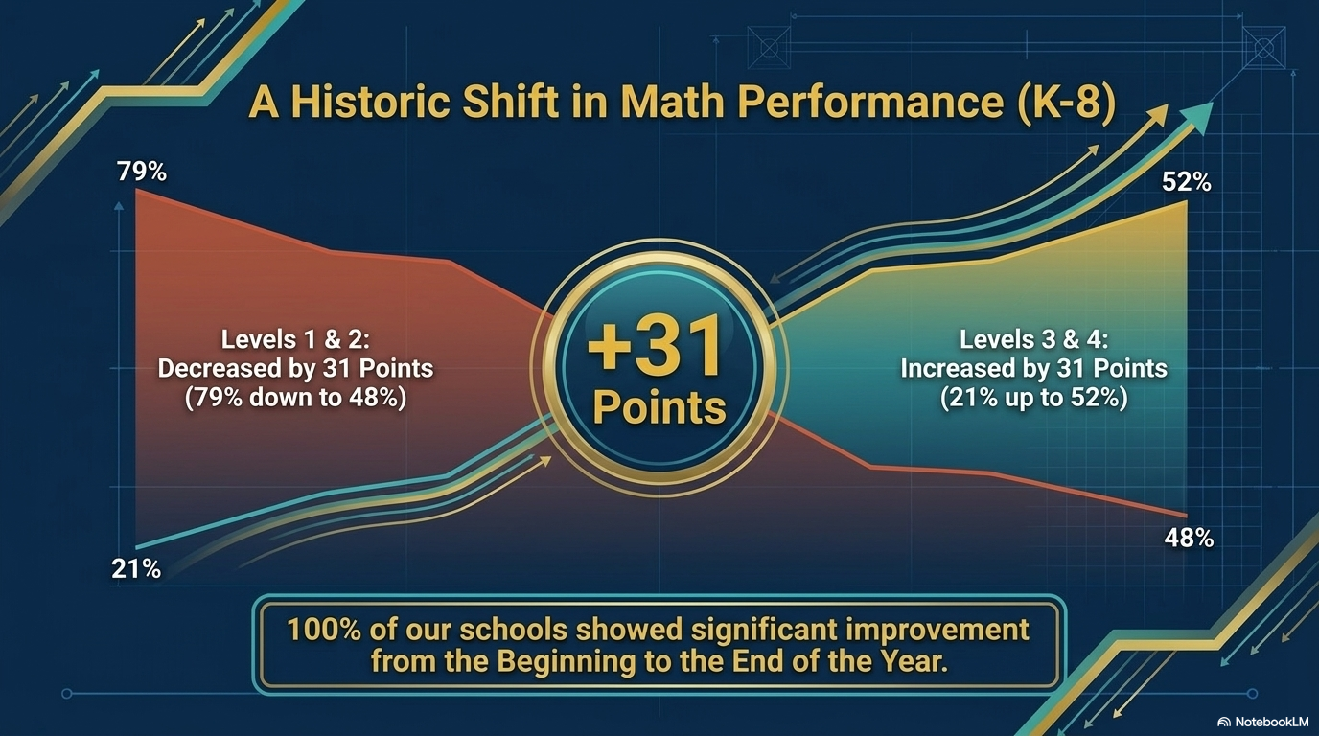

Slide 5


Slide 6
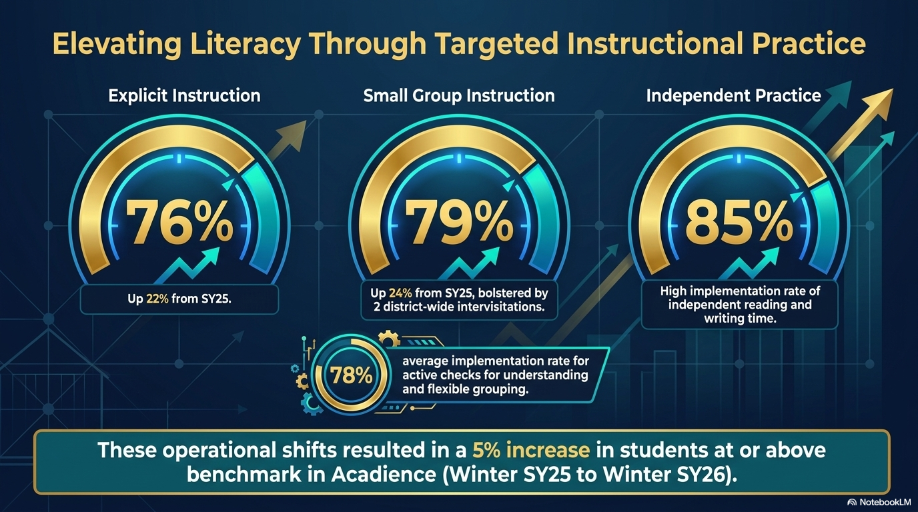

Slide 7
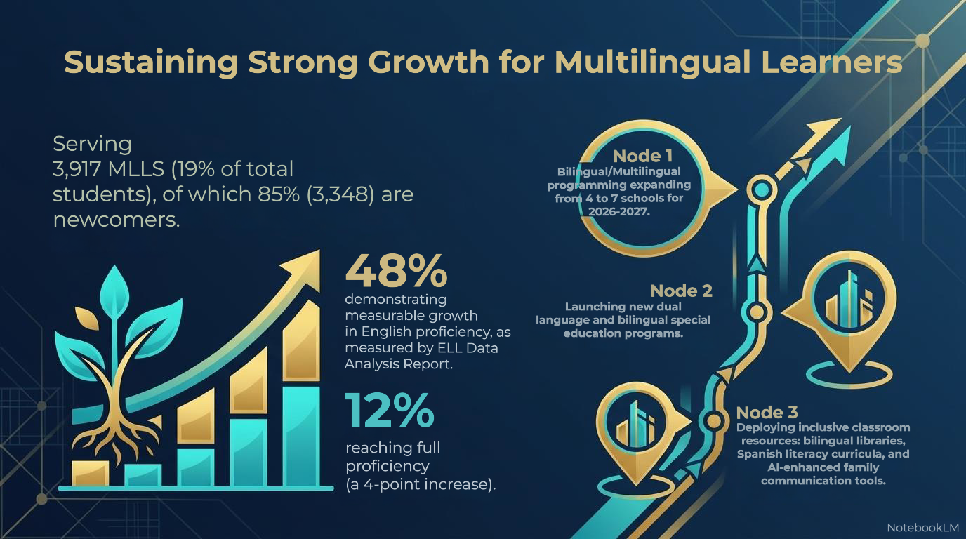
Notes:
ELL Data Analysis Report

Slide 8
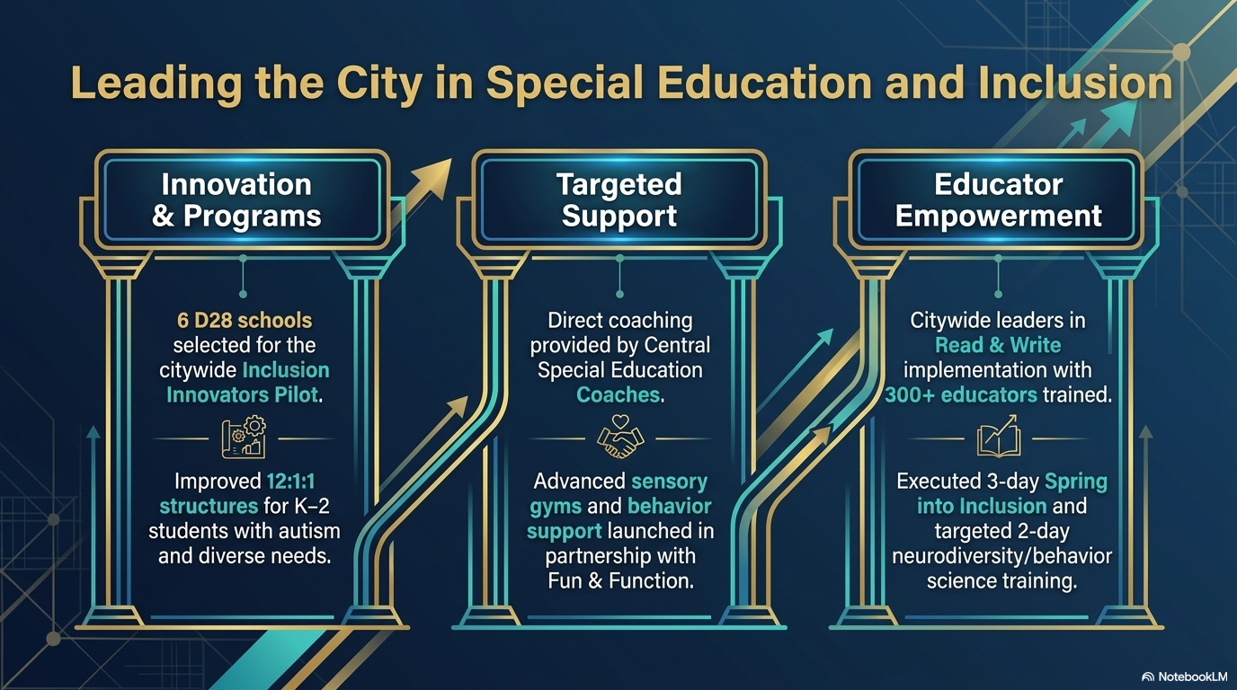

Slide 9

Notes:
National Association of Social Workers (NASW)

Slide 10

Notes:
Franky

Slide 11
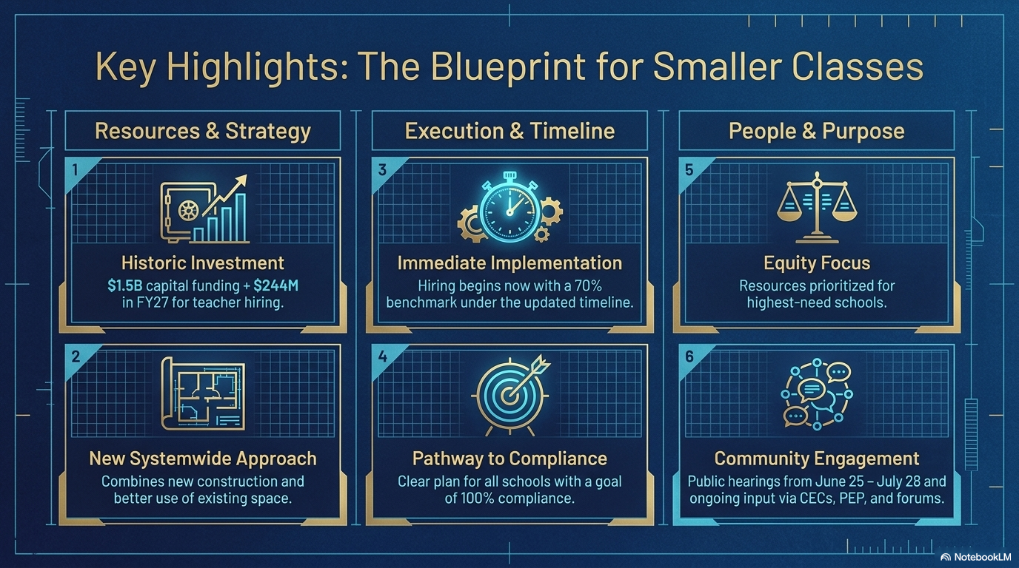

Slide 12
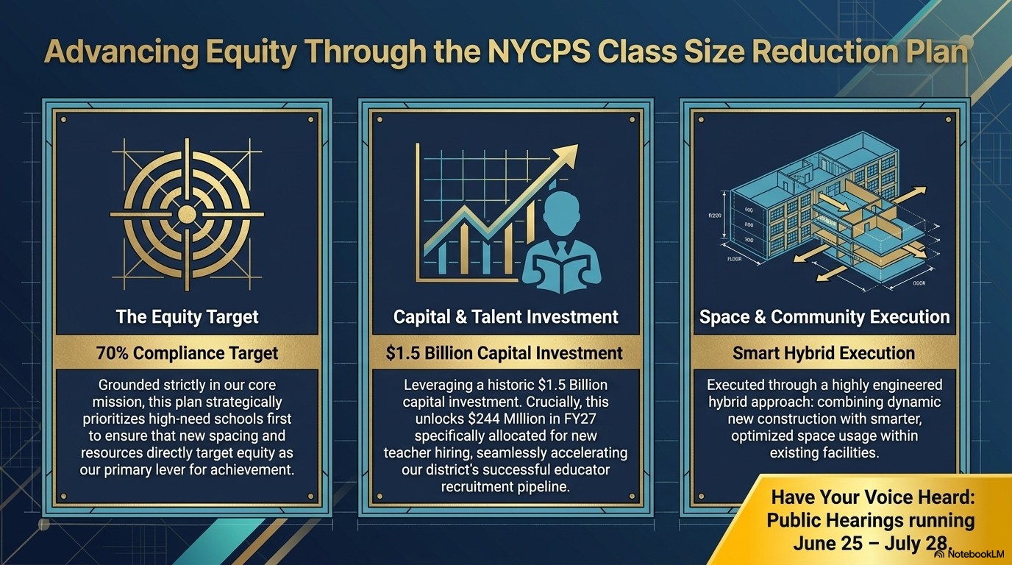

Slide 13
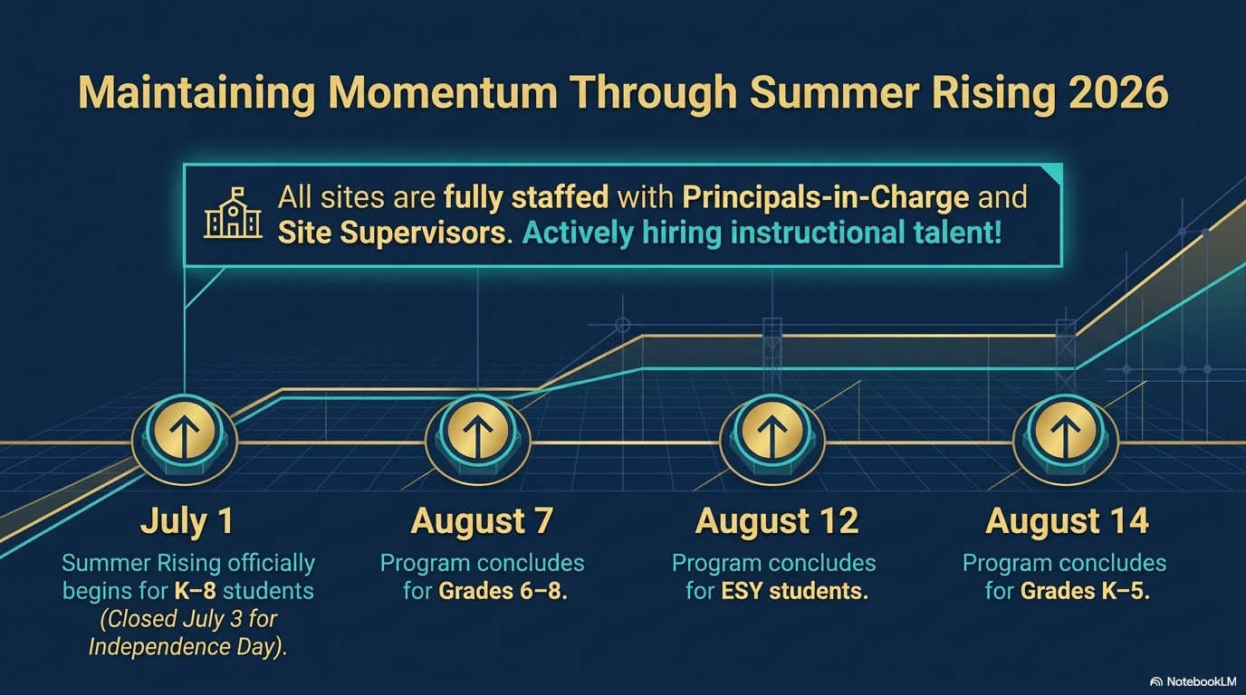

Slide 14


